Slide 1
Correlative Findings in
Cervical Specific Chiropractic
Pattern Analysis Utilizing
Paraspinal Thermography,
Leg Length Inequality and
Heart Rate Variability (HRV) in
Two Patients with Tachycardia
Michael T. Burcon, B.Ph., D.C.

Slide 2
Your Amazing Heart
HRV describes the changes in timing between heart beats, between R waves on a ECG. It is measured 1,000 times per second. Generally, high HRV is considered healthy, allowing the individual to adapt to their environment.
The heart will beat without innervation. It beats about 100,000 times per day. It is influenced as much by chemicals as by electricity. It rarely gets cancer because the cells do not divide in an adult. You have 60,000 miles of blood vessels.

Slide 3
PSVT
Paroxysmal SupraVentricular Tachycardia is a type of “short-circuit” arrhythmia. It may result either from atrio-ventricular nodal re-entrant tachycardia or from an accessory pathway, which may occur as part of the Wolff-Parkinson-White syndrome. Patients with PSVT typically describe a rapid, or racing, regular heartbeat (between 130 and 230 beats per minute) that starts and stops abruptly. Prevalence approximately 2 in 1,000.

Slide 4
POTS
Postural Orthostatic Tachycardia Syndrome is a disorder marked by abnormal blood circulation and blood flow to the brain and heart when standing up from the lying position, causing severe lightheadedness, fainting and a rapid heart rate. Patients are instructed to eat a teaspoon of salt every morning. Prevalence is unknown. Five times more common in women than in men.

Slide 5
A. Case Histories
PSVT
62 y.o. Male
Low Back Pain
Thrown from convertible at 70 m.p.h. age 21
POTS
22 y.o. Female
Migraine
Low Back Pain
Blow over Right Eye requiring stitches age 7

Slide 6
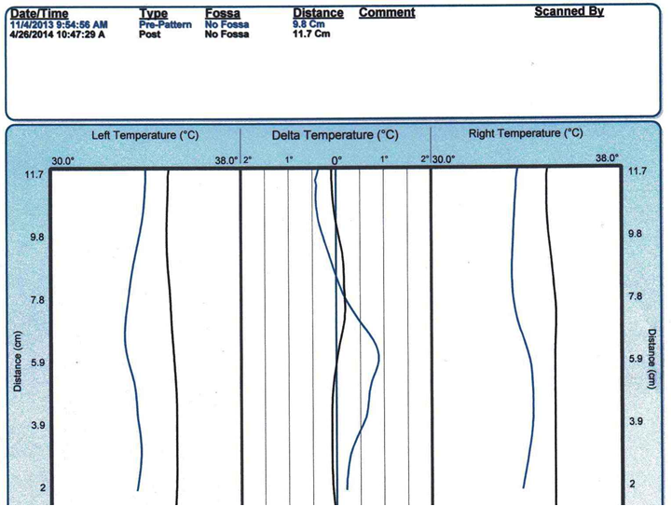
B. Thermography
PSVT

Slide 7
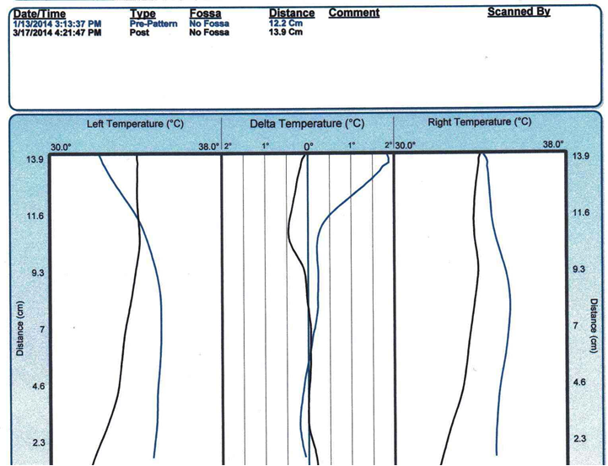
POTS

Slide 8
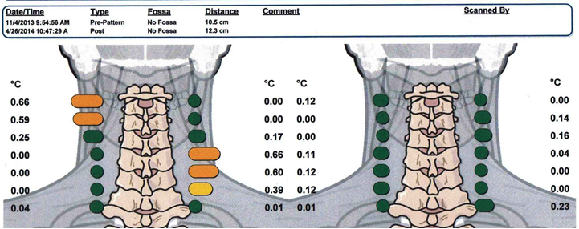
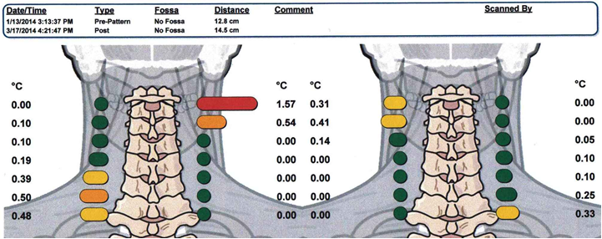
PSVT
POTS

Slide 9
C. 10 Step Cervical Leg Check Protocol
BurconChiropractic.com Information Doctors of Chiropractic Protocol
PSVT POTS
Notate Relative Short Leg* 1” R ½” R
Cervical Syndrome Test** Negative Negative
C1 (Atlas) C1 R++*** Negative
C2 (Axis) Negative C2 R
C3 Negative Negative
C4 Negative Negative
C5 C5 R+ Negative
C6 Negative Negative
C7 Negative Negative
Adjustment Algorithm**** C1 (Atlas) C2 (Axis)
* Measure to closest 1/8”
** Most significant chiropractic test
*** 1/8” – ½” R (Right) or L(Left); 5/8” – 1” +; 1 1/8” – 1 ½” ++; 1 5/8” – 2” +++
**** When one segment goes shorter than any other, adjust it, rest, re-check
When two segments go short equally, adjust both, lower one first, rest, recheck
Always correlate leg checks with x-rays (subluxation may vary one level)
Always adjust upper cervicals last (no exceptions)
When relative short leg changes sides, there are two major vertebral subluxations

Slide 10
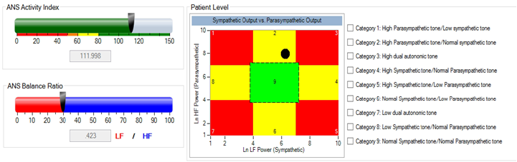
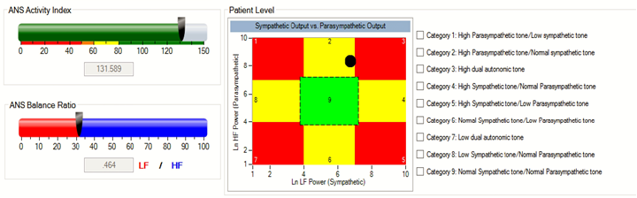
PSVT
POTS

Slide 11
Category 2: High Parasympathetic tone and Normal Sympathetic Tone
Note that the color of this box is yellow. This means that both divisions of the patient’s
nervous system are working, but the parasympathetic division is dominating the sympathetic.
Again, the first thing that you should check is to see if the patient is taking a beta blocker
medication that is slightly suppressing the sympathetic system. If there is no medication that is being used, this patient likely falls into the small percentage of patients who are parasympathetic dominant. They are often easy going individuals who are the classic type “C” personality.
If healthy, these patients will respond well to care, and are often seeking your services for maintenance care, or general health building. These patients are often a joy to work with and certainly not someone to worry about. If however they are sick, they will often be slow to wake up and get going in the morning, have general body aches, alternating constipation and diarrhea, and are often hungry most of the time even if they just ate a large meal.
One theory is that a specific upper cervical adjustment can stimulate the parasympathetic system enough to saturate the heart rate variability system, causing someone who is vulnerable to tachycardia to have an attack.

Slide 12
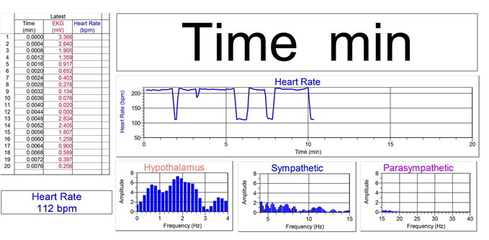
PSVT

Slide 13
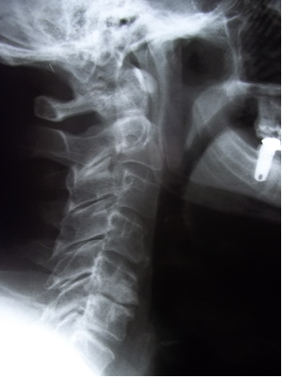
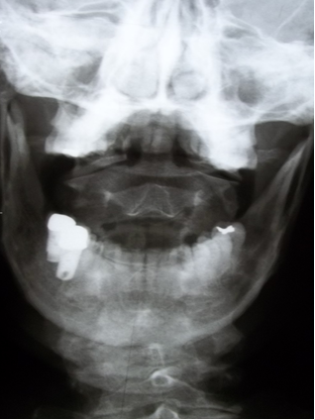
D. Modified Blair/Pierce X-Ray Analysis
PSVT C1 ASR; C5 PLI

Slide 14
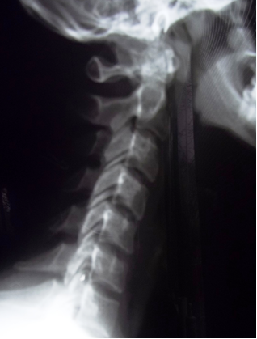
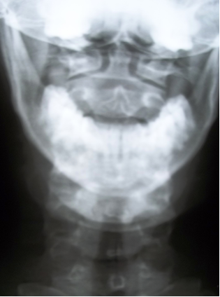
POTS
C1 PIL; C2 PRI; C5 PRI

Slide 15
Correlation
Both patients had Atlas Subluxations on Right Side
Right Vagal Nerve (CNX) primary supply for SA Node
Primarily originates from neurons in the Nucleus Ambiguus
CNX Exits Skull through Jugular Foramen next to Atlas
SA Node is the Heart’s Primary Pacemaker
Sympathetic/Parasympathetic Nervous System to Heart
is an Interactive Complex. They are Not “Opposites.”
Heart Rate primarily controlled by right Vagus Nerve.
The Vagus has an Autonomic Ganglion at the level of Atlas.
Sympathetic supplied by T1 – T4.

Slide 16
Results
PSVT
Low Back Pain Resolved
Heart Ablation Surgery Cancelled
POTS
Migraines Resolved
Low Back Pain Exacerbated from Fall on Ice
POTS Unchanged

Slide 17
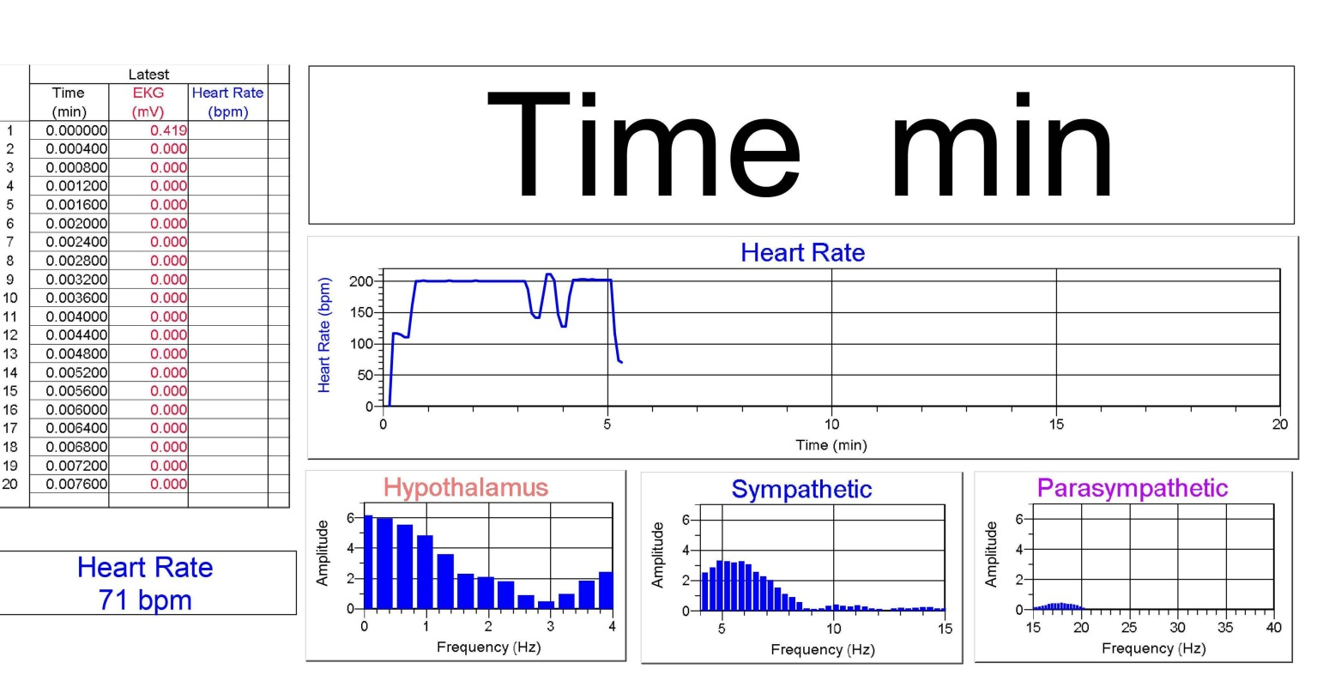
46 y.o. Female; Lumbago, Vertigo, Tinnitus, Cervicalgia, Migraines, POTS
Pulse: 71 – 217 b.p.m.

Slide 18
