Slide 1

Cervical Specific Protocol and Results
for 300 Meniere’s Patients
Followed for a Minimum of Six Years
Michael T. Burcon, B.Ph., D.C.
Meniere’s Research Institute
Burcon Chiropractic
Grand Rapids, MI USA

Slide 2
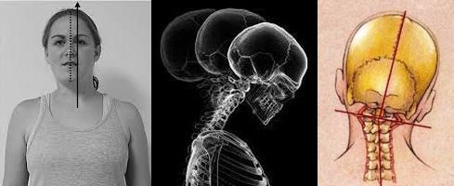
Meniere’s Disease is a Syndrome Caused by Whiplash/Concussion
Translation Anterior Head Carriage Head Tilt
Meniere’s patients have one, two or all three of these presentations.

Slide 3
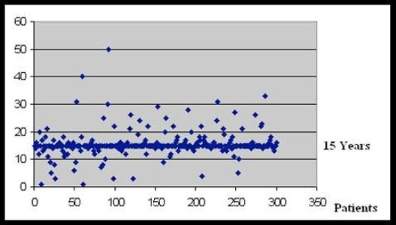
It takes an average of 15 years
from the time of the trauma
before the onset of symptoms.

Slide 4
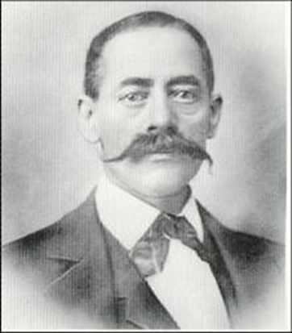
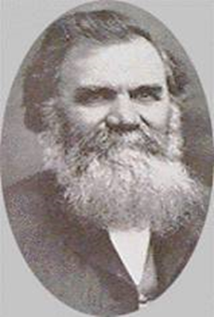
September 18, 1895
Harvey Lillard
Black male janitor presented with almost total deafness
Case history: He was working in a stooped, cramped position when he felt something pop and heard a crack in his neck, immediately losing his hearing.
D.D. Palmer, D.C., Magnetic Healer
Discovered a bump on the back of Mr. Lillard’s neck at the level of C2 (Axis)
Performed the first chiropractic adjustment, restoring Harvey’s hearing.

Slide 5
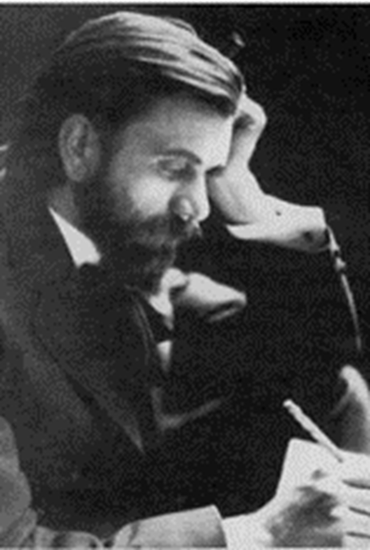
BJ Palmer, DC
Son of DD Palmer
Took over Palmer Chiropractic College from his father.
Started researching upper cervical specific chiropractic in 1931 until his death in 1961.
I resumed his research in 1999, specializing in Meniere’s disease.
I am looking for an MD to coauthor paper for presentation at the International Meniere’s Symposium in Paris in 2020.

Slide 6
Cervical Specific Chiropractic Protocol
Case history
Posture analysis
Thermography
Leg length inequality tests
Pattern work
Cervical x-ray analysis
Adjustments
Resting
Rechecking
Return in 2 to 5 days for post check

Slide 7
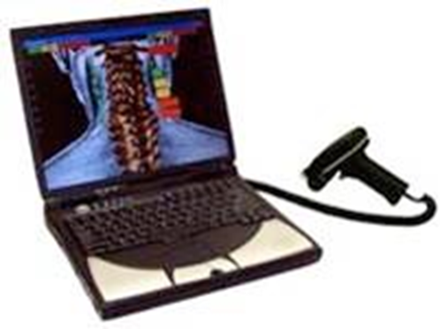
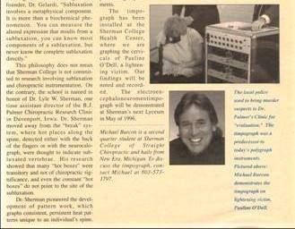
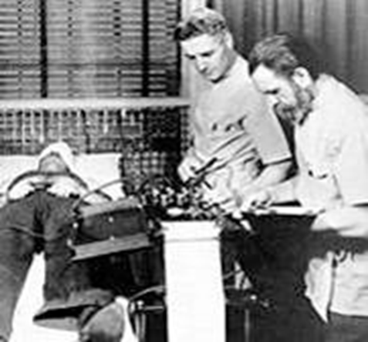
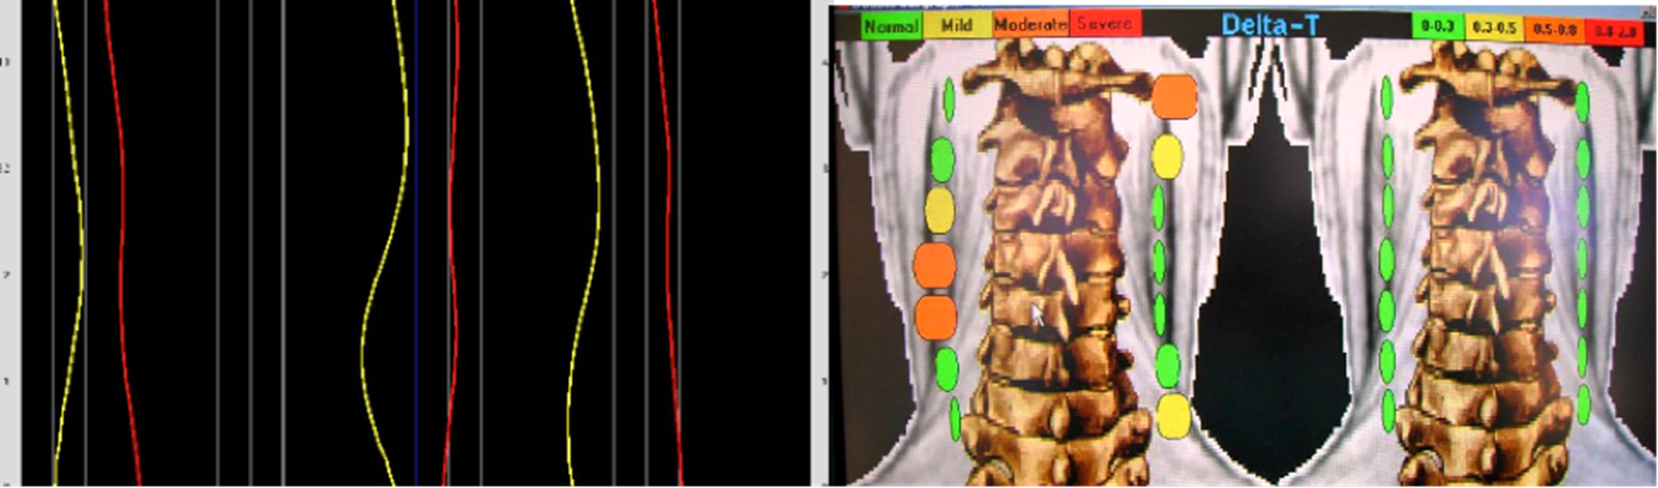
THERMOGRAPHY
BJ Palmer, DC
Left Thermocouple ~ Delta T ~ Right Thermocouple ~ Right Meniere’s Pre Adjustment ~ Post Adjustment

Slide 8
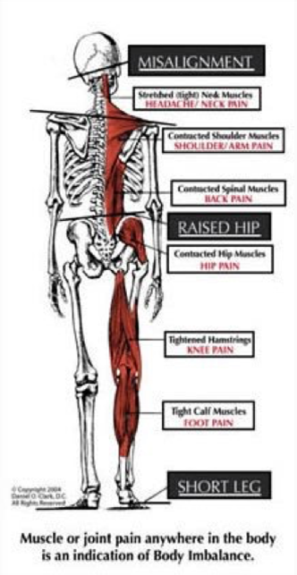

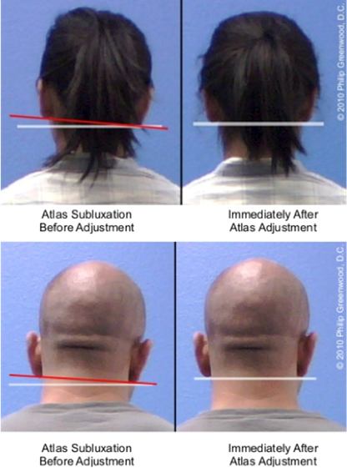
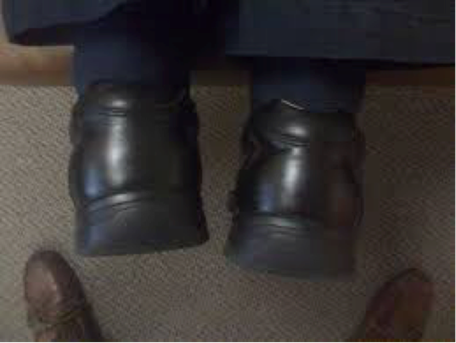
Leg Length Discrepancy Tests ~ Cervical Syndrome Test
Head tilt will make you dizzy.
The body has two spinal gyroscopes:
Top one: Occiput/Atlas/Axis
Bottom one: L5/Sacrum/Ilium
Innate Intelligence of body will protect the brainstem at all costs,
sacrificing the lower extremities.
Chiropractors balance the legs by balancing the skull on the neck.
This is done by specifically adjusting the upper cervicals.

Slide 9
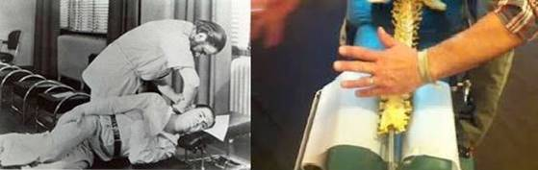
Side Posture Adjustment Atlas & Axis ~ Posterior Adjustment in Lower Cervicals

Slide 10
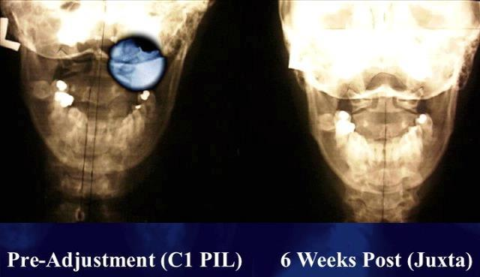
Upper Cervical Correction
Right Unilateral Meniere’s
Four Atlas Listings:
Anterior and Superior on the Right
Anterior and Superior on the Left
Posterior and Inferior on the Right
Posterior and Inferior on the Left
90% Posterior and Inferior on the Opposite Side of Problem

Slide 11
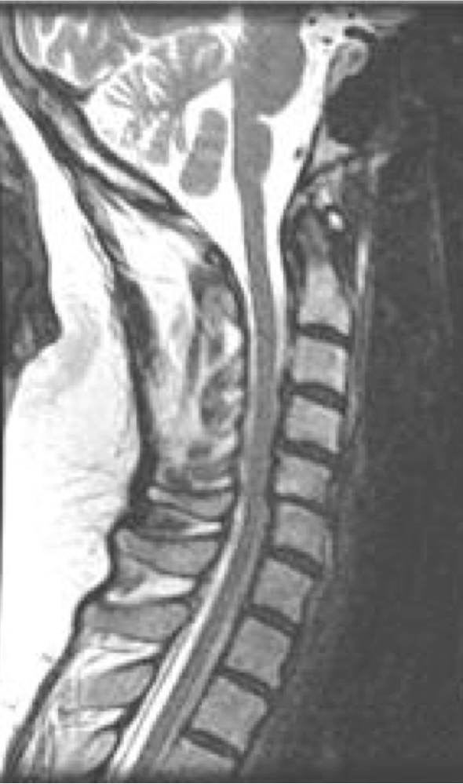
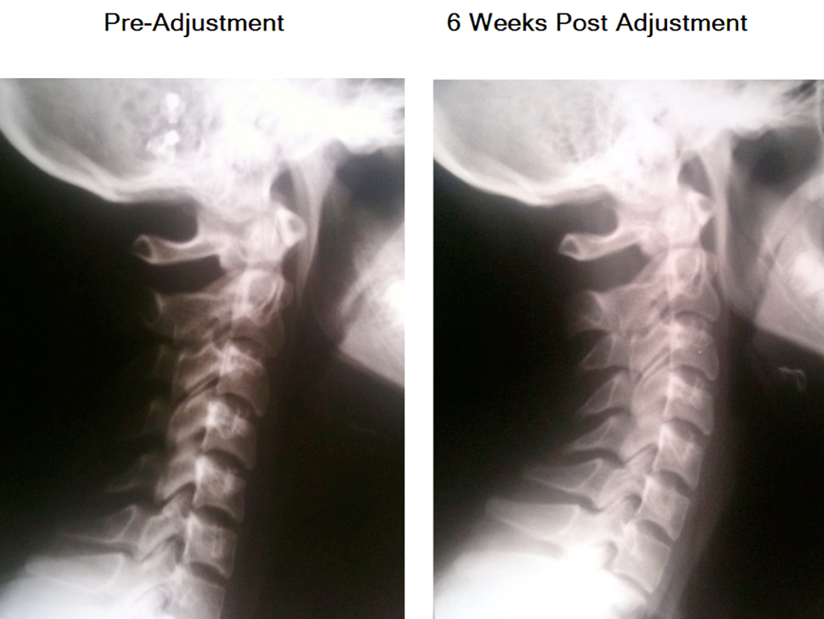

Films Demonstrating Correction of C5 Subluxation

Slide 12
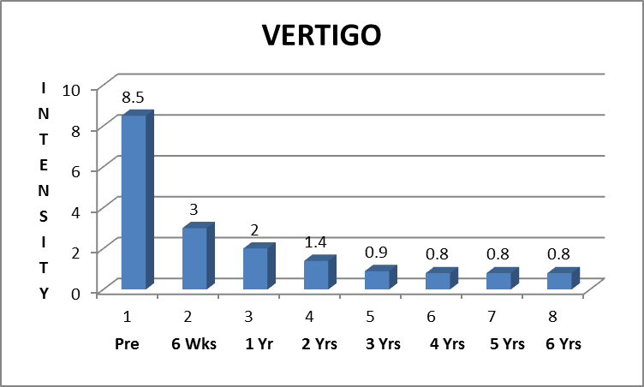

Slide 13
Invitation:
Demonstrating my protocol tomorrow,
Wednesday, June 8th from 14:00 – 16:00,
Club Lounge meeting room on 26th floor of Grand Intercontinental Seoul Parnas.
If you could bring a Meniere’s patient,
that would be great!

Slide 14
HYPOTHESIS:
Upper Cervical Subluxation Complex will create
some combination of the following 8 Lesions:
1. Auditory tube dysfunction
A. Near the opening in the nasopharynx caused by atlas/axis subluxation
B. Near the opening in the middle ear via tensor vili palatina muscle caused by torqueing of CNV
2. Traction of CNVIII
3. Insufficient blood supply to the inner ear
A. Cork in the bottle syndrome causing venous backflow
B. Less blood flow in the vertebral artery on side of the
affected ear
4. Chronic CSF back jets into the fourth ventricle
5. Confusion of the Vestibular nuclei
6. Irritation of the nerve supply to the endolymphatic sac

