Slide 1
Cervical Specific Protocol and Results for
300 Meniere’s Patients Followed for a
Minimum of Five Years
Michael T. Burcon, B.Ph., D.C.
Meniere’s Research Institute
Burcon Chiropractic
Grand Rapids, MI 49546
Epidemiology of Meniere’s Disease
7th International Symposium on
Meniere's Disease and Inner Ear Disorders
Rome, Italy, October, 2015

Slide 2
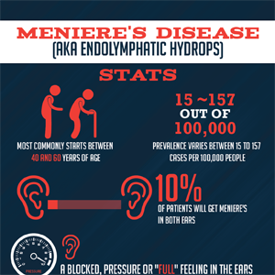
Inaccurate Information Provided by Internet: based on 3,678
PUBMED articles: Meniere’s disease is not synonymous with endolymphatic hydrops. Onset is between 30 and 50.
Prevalence is 2 out of 1,000, and about
30% of Meniere’s patients develop bilaterality.

Slide 3
In 1938, Hallpike and Cairns in London and Yamakawa in Japan described the pathological finding of endolymphatic hydrops (EH) in the temporal bones of patients with Meniere’s disease (MD) at autopsy. The two terms have been used almost interchangeably ever since.
Intratympanic delivery of gadolinium selectively enhances perilymph, delineating it from endolymph utilizing scanners with greater magnetic strength and improved image sequencing. Some patients with MD do not have EH. Many people with EH do not have MD. Most patients with unilateral MD were found to have bilateral idiopathic endolymphatic hydrops with this new imaging technique.
The Merck Manual states that endolymphatic hydrops is caused by the accumulation of the fluid of the membranous labyrinth of the ear, caused by the over production or under absorption of that fluid.
But the important question that remains unanswered after 150 years is what homeostasis disorder causes that accumulation of excess fluid?

Slide 4
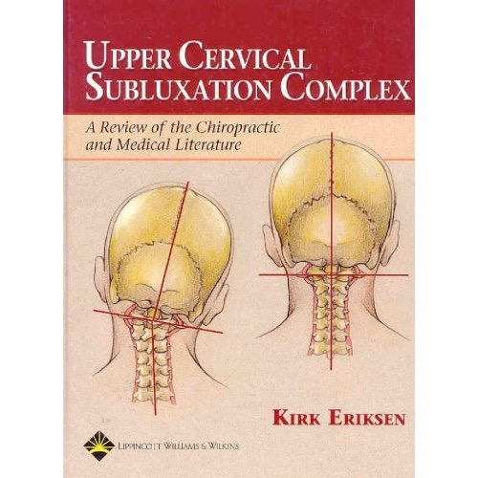
Meniere’s:
A Disease or a Syndrome?
Chiropractors call it an upper
cervical subluxation complex.

Slide 5
Upper Cervical
Complexes are
commonly caused by Whiplash.

Slide 6
T
There are multiple contributing factors
(i.g. genetics, allergies) to Meniere’s disease, and
several common triggers (i.g. spike in salt intake,
dramatic change in dew point),
but there is only one cause.
Meniere’s disease is caused by
Whiplash.

Slide 7
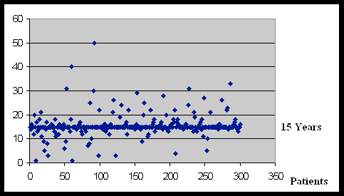
It takes an average of 15 years
from the time of the injury
until the onset of symptoms, so
the correlation is rarely made.

Slide 8
There are three presentations of
Whiplash. The complex can be a
combination of one, two or all
Three of the following:
Loss of the Normal Cervical Curve
Translation of the Head
Head Tilt
(From the front, normal spines are straight,
from the side, they are curved. Ninety percent
of MD patients present just the opposite.)

Slide 9
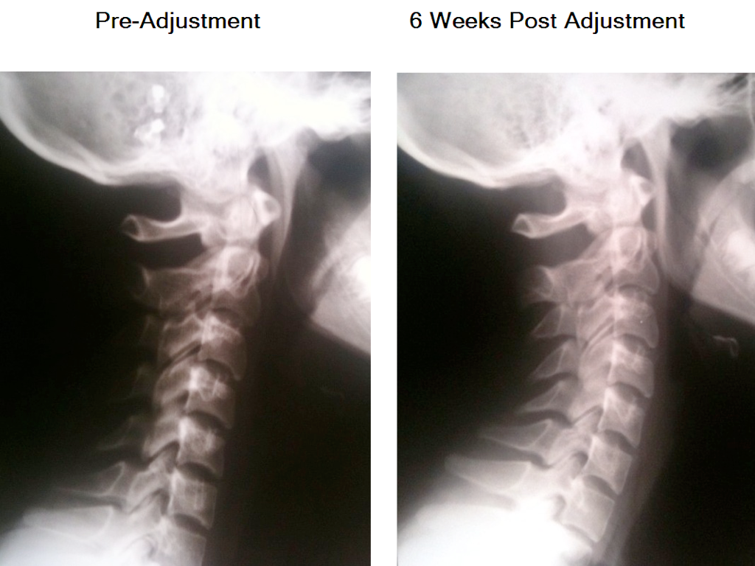

Typical Rear Ended Whiplash
Mild Reverse Curve
Kink

Slide 10
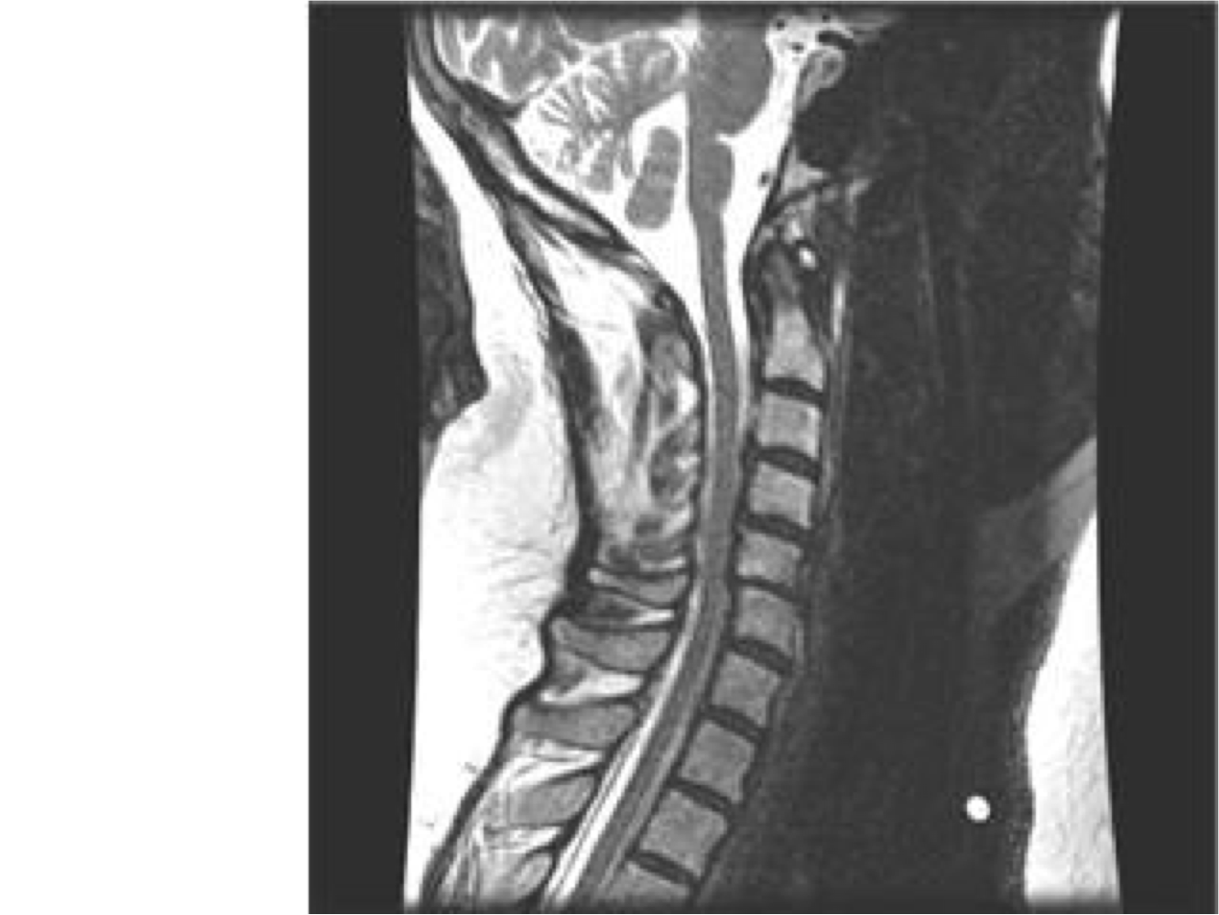
Results in Demyelination of the
Lower Cervical Dura
Approximately 15 Years Post Trauma
Posterior C5
Damaging
Meninges

Slide 11
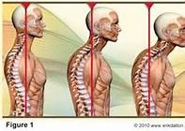
When the head is fixated forward with a
Posterior Atlas Subluxation,
unless corrected by an
Upper Cervical Specific Chiropractor,
The patient will continue to bend forward
for the rest of their lives.

Slide 12
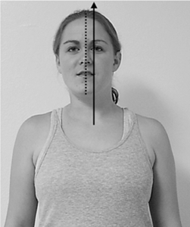
Side Impact Whiplash =
Left Head Translation
Head Fixated to One Side
Example: T-Bone Vehicular Accident
Notes:
Harder to correct. Adjustments against boney lock of atlas articulation. Have to use torque to separate them.

Slide 13
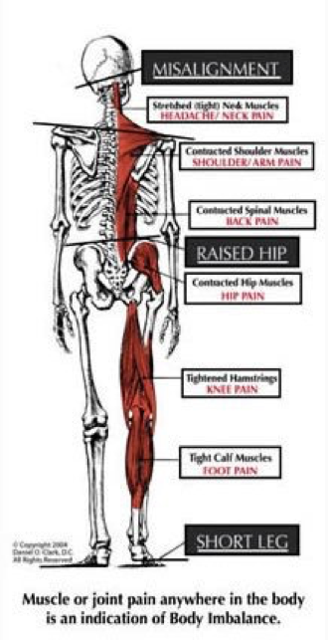

Head tilt will
make you dizzy,
so your body
has two built-in
Gyroscopes.
Your Innate
Intelligence will
protect your brainstem at any cost.
Occiput
Atlas
Axis
L5
Sacrum
Ilium
Notes:
Will make you dizzy

Slide 14
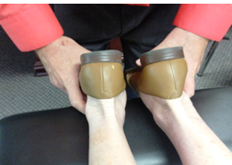
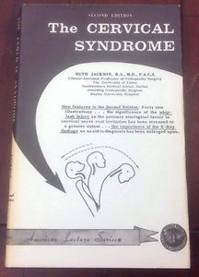
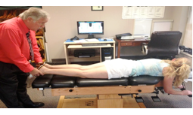
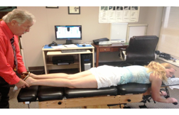
Cervical Syndrome Test
by Ruth Jackson, MD in 1949
“Slowly turn your head to the left, relax.
Back to the center.”
2. If leg length changes only to the right, notate
change as Right Cervical Syndrome (RCS)
to closest 1/8.” If it changes only to the left,
notate LCS. If it changes in both directions,
it is a Bilateral Cervical Syndrome (BLCS).
(No change in relative leg length is a negative
test and nothing is notated. If it is positive,
Atlas, and/or Axis are subluxated.)
Note: We consider this test to be the most
accurate for determining the existence of an
upper cervical subluxation complex.
1. Notate relative short leg to closest 1/8”
(3/8” Left Relarive Short Leg)
“Gently turn your head to the right,
and relax.”

Slide 15
HYPOTHESIS:
Upper Cervical Subluxation Complex will create
some combination of the following 8 Lesions:
Auditory tube dysfunction
    A. Near the opening in the nasopharynx caused by atlas/axis subluxation
    B. Near the opening in the middle ear via tensor vili palatina muscle caused by torquing of CNV
Traction of CNVIII
Insufficient blood supply to the inner ear
A. Cork in the bottle syndrome causing venous backflow
B. Less blood flow in the vertebral artery on side of the
affected ear
4. Chronic CSF backjets into the fourth ventricle
Confusion of the Vestibular nuclei
Irritation of the nerve supply to the endolymphatic sac

Slide 16
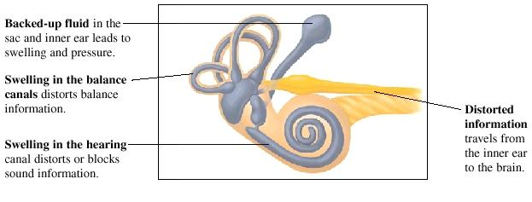
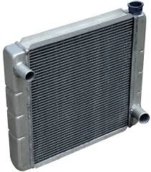
Theory 6
Although the mechanism for production and absorption of endolymphatic fluid is not fully understood, can
we agree that the endolymphatic sac is the key player? For our analogy, let’s compare it to your cars radiator.

Slide 17
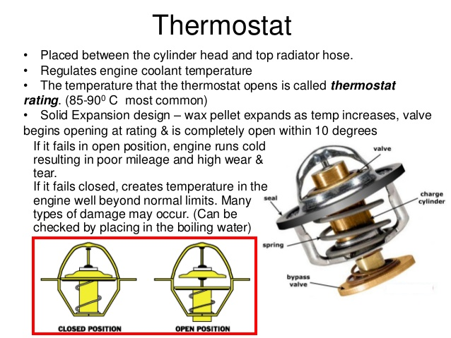
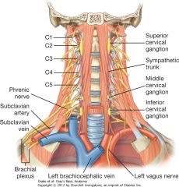

Homeostasis of your ears
“radiator” is
controlled by
its “thermostat.”
The endolymphatic sac, innervated by the superior cervical
ganglion, performs both absorptive and secretory
(overflow system controlling homeostasis),
as well as phagocytic and immunodefensive functions.
It is located intimately close to the
articulations between C1 (Atlas) & C2 (Axis).

Slide 18

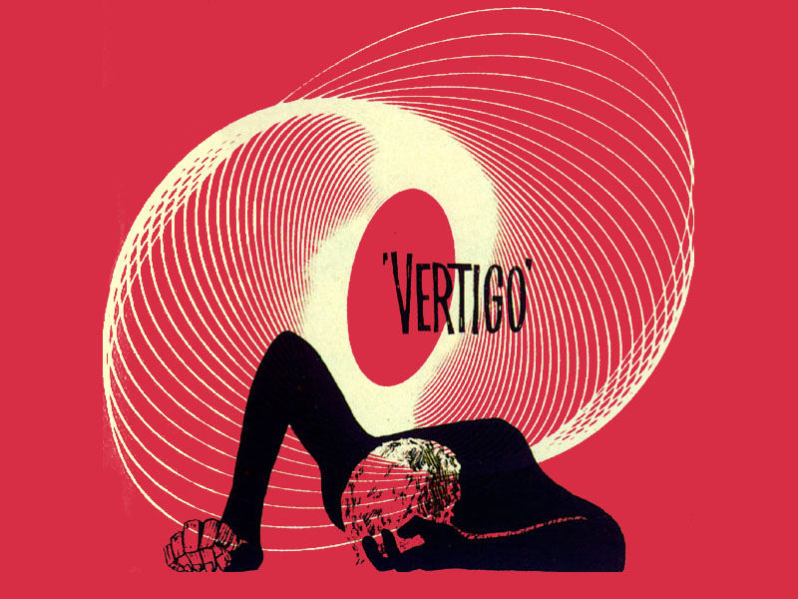
Result of the lack of homeostasis:
You won’t be going anywhere for awhile.

Slide 19
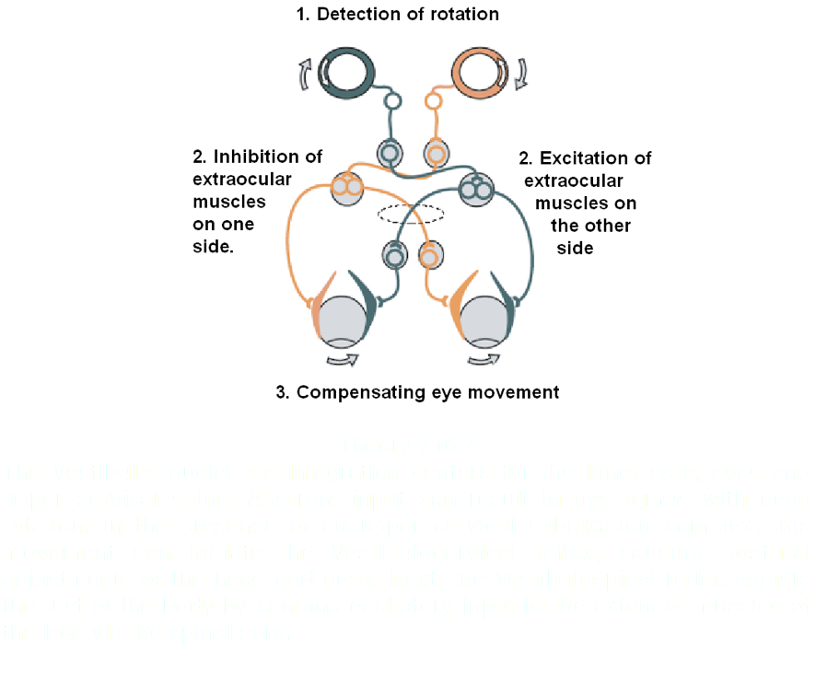
Theory 5

Slide 20
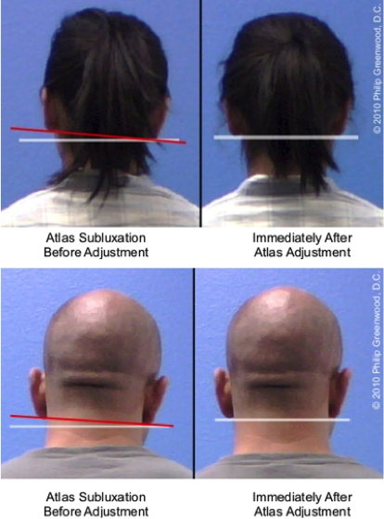
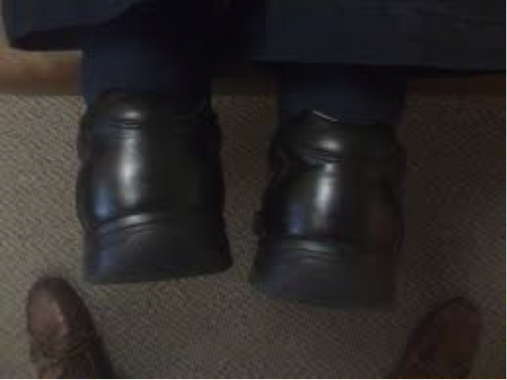
This reflex causes a relative leg length discrepancy.
The innate intelligence of the patient will sacrifice
their lower extremities to protect the brainstem
3/8” Left Relative Short Leg
Notes:
Can be done with patient prone or supine.

Slide 21
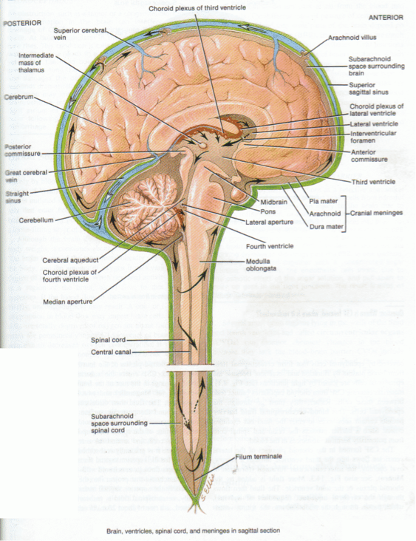
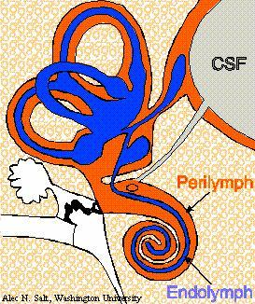
Theory 4
Chronic CranioSacral Fluid backjets into the fourth
ventricle, causing decreased CSF pressure in the inner ear from the posterior fossa via
the Cochlear aqueduct.

Slide 22
HYDROLIC SYSTEM
Chronic craniocervical venous back pressure and subsequent neurodegenerative conditions lead to chronic venous backups and edema in the brain, also affecting cerebrospinal fluid flow and volume. Edema formation frequently complicates head/neck trauma. Recent studies have revealed the existence of a brain-wide paravascular pathway for cerebrospinal (CSF) and interstitial fluid (ISF) exchange, the glymphatic system. Correct CSF volume is essential to normal pressure hydrocephalus, which has been associated with other one-sided neurological disorders like MS, Parkinson’s and Alzheimer’s. The vertebral-basilar arterial supply to the brain is one of the main suspects in demyelination. The most likely place for obstruction to CSF flow to occur is in the upper cervical spinal canal. The cause can be genetic design problems and/or whiplash. There is a principle in neurology that there are essentially two fluids inside the cranial vault, the blood and CSF. Since the cranial vault is a closed container, if the volume of one of the elements increases, then the other fluid must decrease in volume. In a recent Italian studies, MD and MS patients exhibited obstructions to this flow when examined by phase coded CSF cinematography in the upright position.

Slide 23
Predictions coming from the NFL concussion lawsuit:
"Medicine will starting looking at the brain, spinal cord, and spine together. The emphasis is on the together part. Medicine sees a brain injury as something that only exists in the brain, and a neck injury as only something that exists in the neck, but the blood, tissue, and cerebral spinal fluid are all continuous between these two parts of the body.
Symptoms of brain trauma can actually be symptoms of neck trauma, and vice versa,” said Guskiewicz. He dedicated his career to discovering and harnessing knowledge about head injuries. Now, he's a highly regarded concussion expert and the recipient of the $500,000 Genius Award.
Please, include the cervicals when ordering brain film studies, and have them taken in a weight bearing position when possible.

Slide 24
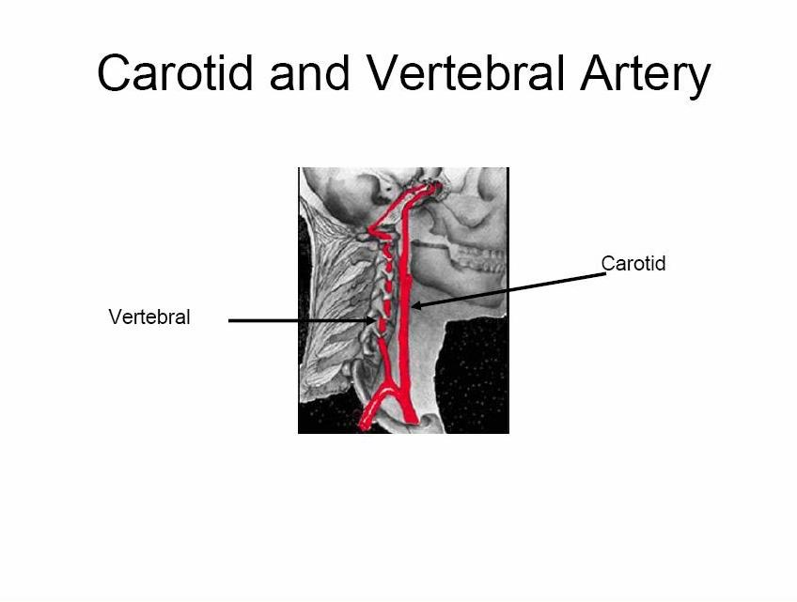
THEORY 3B
Irritation of the sympathetic nerves eliciting spasms within the vertebral artery, leading to a decrease in blood flow to the brainstem and inner ear. Vertebral artery passes through atlas bilateraly.

Slide 25
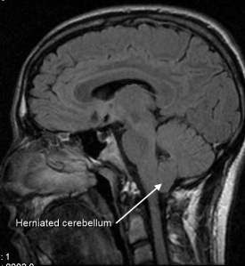
Theory 3A
CORK IN THE BOTTLE SYNDROME
MRI OR C-SCAN MUST BE TAKEN UPRIGHT
Raymond Damadian is a medical practitioner and inventor of the first MR (Magnetic Resonance) Scanning Machine and later, the stand-up MRI system. There are also seated MRI’s
Tonsillar (downward cerebellar) from whiplash
Recent research shows a correlation between trauma and Chiari. Hyperflexion type strains of the cord, in which the neck over stretches as it is pulled forward by the weight of the head moving in a chin toward the chest direction, can traction the brainstem and pull it down toward the foramen magnum. On the way down it causes a compression deformation of the larger part of the brainstem in the foramen magnum. The action would be similar, for example, to pushing a cork into the top of a wine bottle. The cork compresses and deforms as it enters the bottle top. As the driving force is released the cork then expands and becomes trapped in the bottle top. If you turn the bottle upside down the wine cannot get past the cork. In the brain, blood and cerebrospinal fluid similarly get trapped.

Slide 26
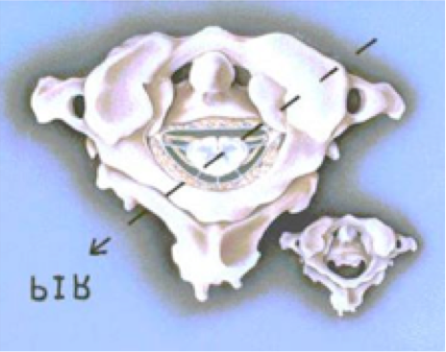
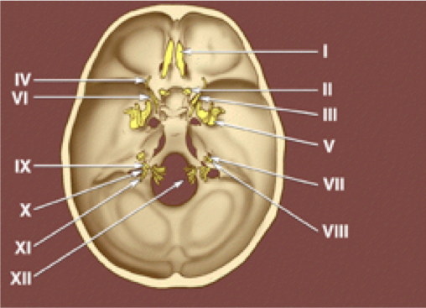
PIL
THEORY 2
Traction of Cranial Nerves VII through XII,
and Arnold’s nerve, the auricular branch
from superior ganglion of X and
inferior ganglion IX.
If atlas subluxates PIL (posterior and inferior on the left side), it creates a subluxation on the right side, stretching and irritating CN VIII.
Notes:
Thanks Fred.

Slide 27
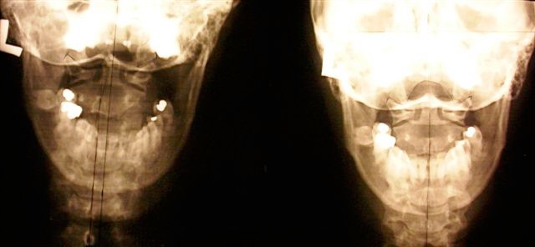

Lesion
Pre-Adjustment (C1 PIL) 6 Weeks Post (Juxta)
Patient with Right Unilateral Meniere’s Patient is off Medication and Symptom free

Slide 28
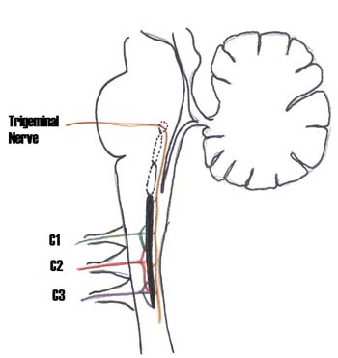
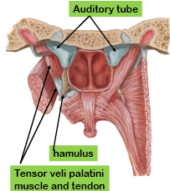
THEORY 1B
Torque of the Trigeminocervical nucleus and tract contributing to Eustachian Tube dysfunction.
Tensor veli palatine muscle innervated by CNV.

Slide 29
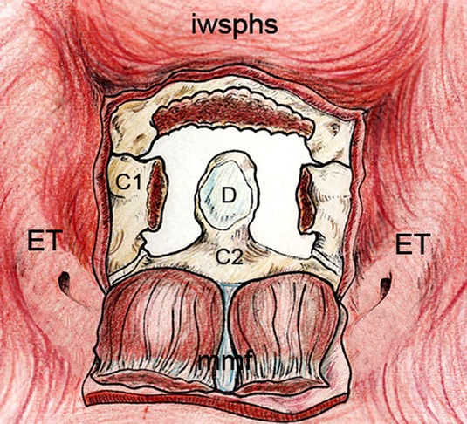
THEORY 1A
Inflammation of the Subluxated Atlanta Occipital
Articulation with edema putting pressure on adjacent structuress,
like the Eustachian tube.

Slide 30
Cervical Specific Chiropractic Protocol
Case history
Posture analysis
Thermography
Leg length inequality tests
Pattern work
Cervical x-ray analysis
Adjustments
Resting
Rechecking
Return in 2 to 5 days for post check

Slide 31
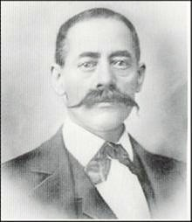
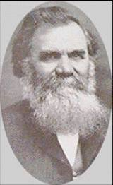
Chiropractic History
1895: First chiropractic adjustment performed on
Harvey Lillard by magnetic healer D.D. Palmer.
The C2 (Axis) correction restored his hearing.
Harvey D.D.

Slide 32
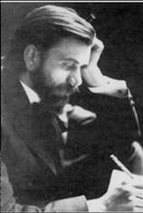
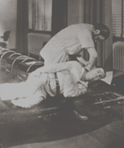
D.D.’s son, B.J. Palmer
Together they started the first
chiropractic college in
Davenport Iowa.
In 1931 B.J. started researching
the hole-in-one (HIO)
upper cervical specific
chiropractic technique.

Slide 33
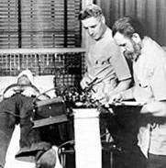
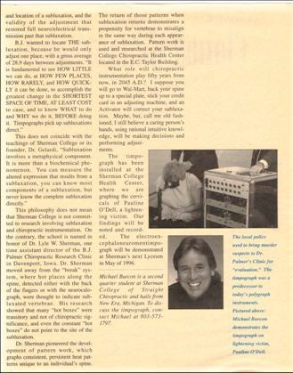
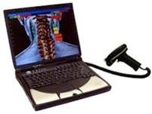
B.J. started a research clinic,
directed by Lyle Sherman, D.C.
In 1924 he developed the NCM, then
electroencephaloneuromentimographs
and started researching pattern work, used to determine when to adjust.

Slide 34
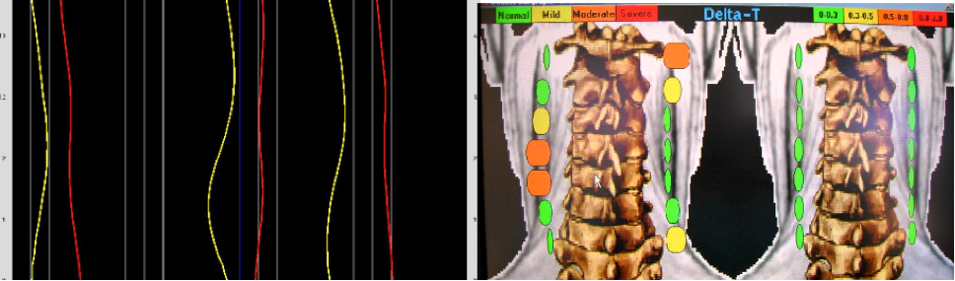
TYTRON THERMOGRAPHY

Slide 35
  All 300 consecutive Meniere’s patients tested positive for upper cervical subluxations.
  3 Cervical X-rays taken and analyzed:
  Lateral, A-P Open Mouth & Nasium.
  All 300 film studies showed evidence of upper cervical subluxation and whiplash, although cervical trauma was denied by over 50% of these patients.
BLAIR ATLAS LISTINGS
ASR- Anterior and Superior on the Right
ASL- Anterior and Superior on the Left
PIR- Posterior and Inferior on the Right
PIL- Posterior and Inferior on the Left

Slide 36
Atlas listings for 300 Patients
0- Anterior and Superior on opposite side of involved ear
18- Anterior and Superior on the side of the involved ear
12- Posterior and Inferior on the side of the involved ear
270- Posterior and Inferior on the opposite side of the involved ear

Slide 37
X-Rays Show Us How to Adjust
Pattern Work Tells us When and Where to Adjust
(Specific Chiropractors do Not Adjust on Every Visit)
Pattern Determined by:
Thermography
Detailed Relative Leg Length Inequality Tests

Slide 38
Levels of Cervical Involvement
Upper Cervicals
When atlas is the major subluxation, vertigo with vomiting are the major symptoms.
When axis is the major subluxation, hearing loss, ear fullness and tinnitus are the major symptoms.
Pairs of Subluxations
Atlas and C5 most common
Axis and C6 next most common
Both pairs are the next most common:
these patients typically can not drive or work. They rarely leave their homes.

Slide 39
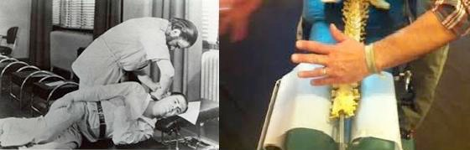
ADJUSTMENTS
Upper Cervicals Lower Cervicals

Slide 40
  All of the following conditions exhibit hyper-activation of the
  Trigeminal ganglion when symptomatic on PET scan:
  Meniere’s syndrome
  Migraine headache
  Trigeminal neuralgia
  Bell’s palsy
  Parkinson’s disease
  Glossopharyngeal neuralgia
  Additionally, patients with one of these conditions are three as likely to
  experience another one of these conditions in their lifetime.
  More than 9 out of 10 benefit from cervical specific chiropractic care.

Slide 41
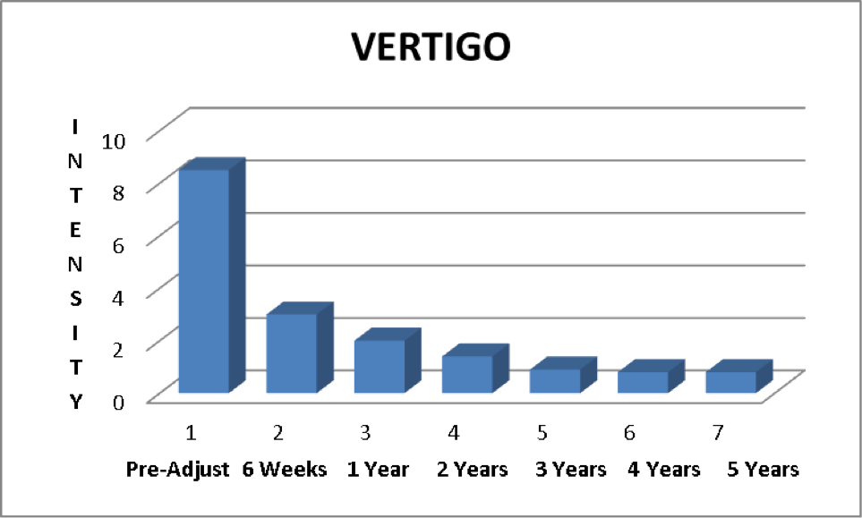
Over 90% Improvement in Frequency and Intensity of Vertigo with Cervical Specific Care

Slide 42
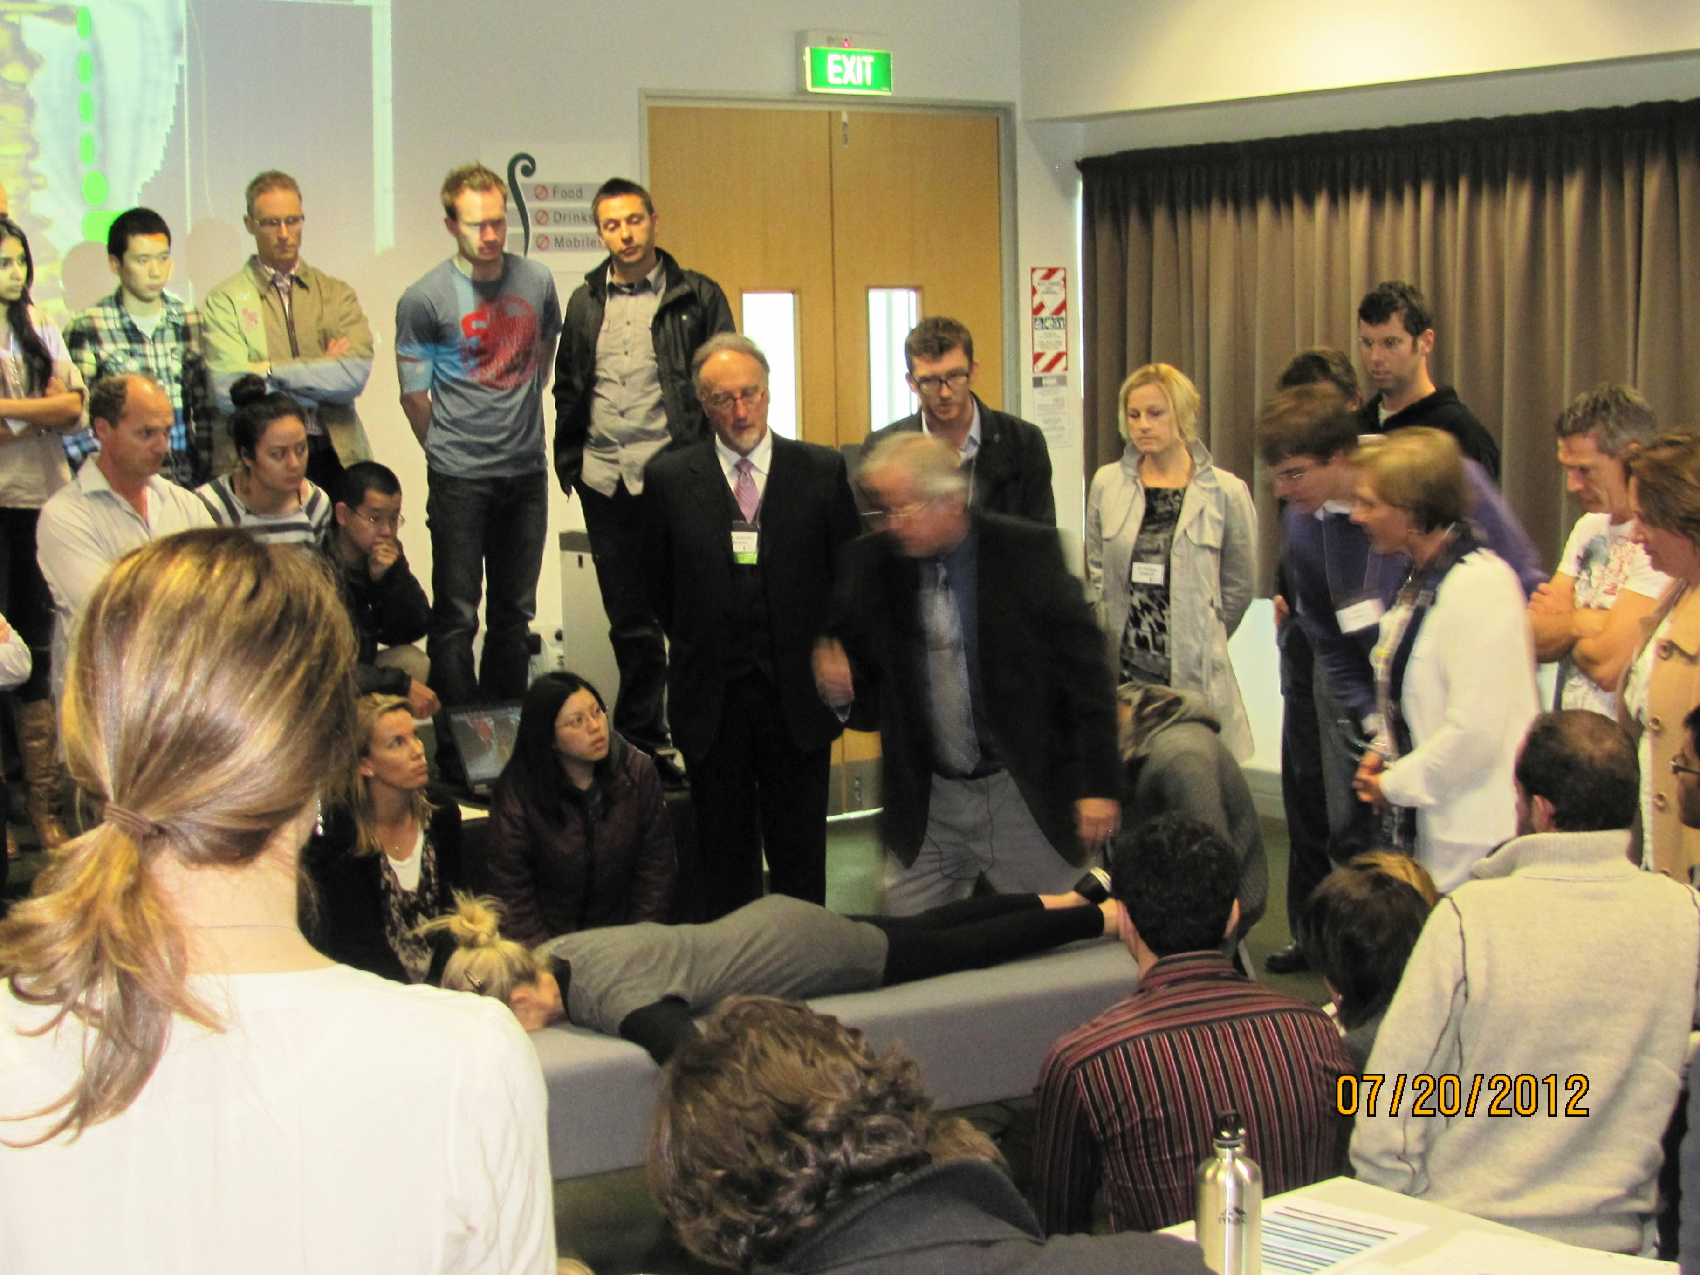
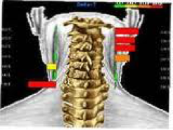
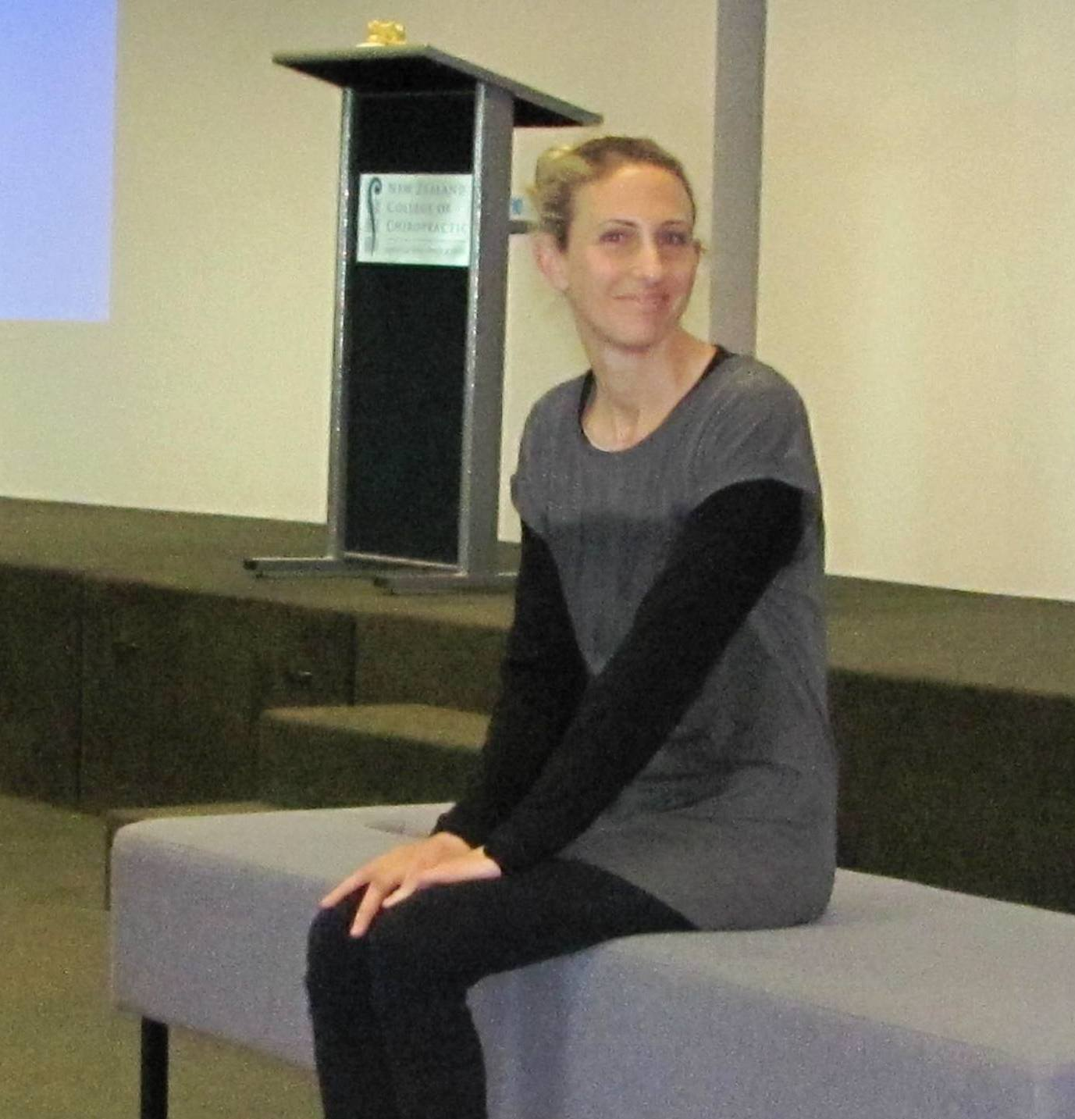
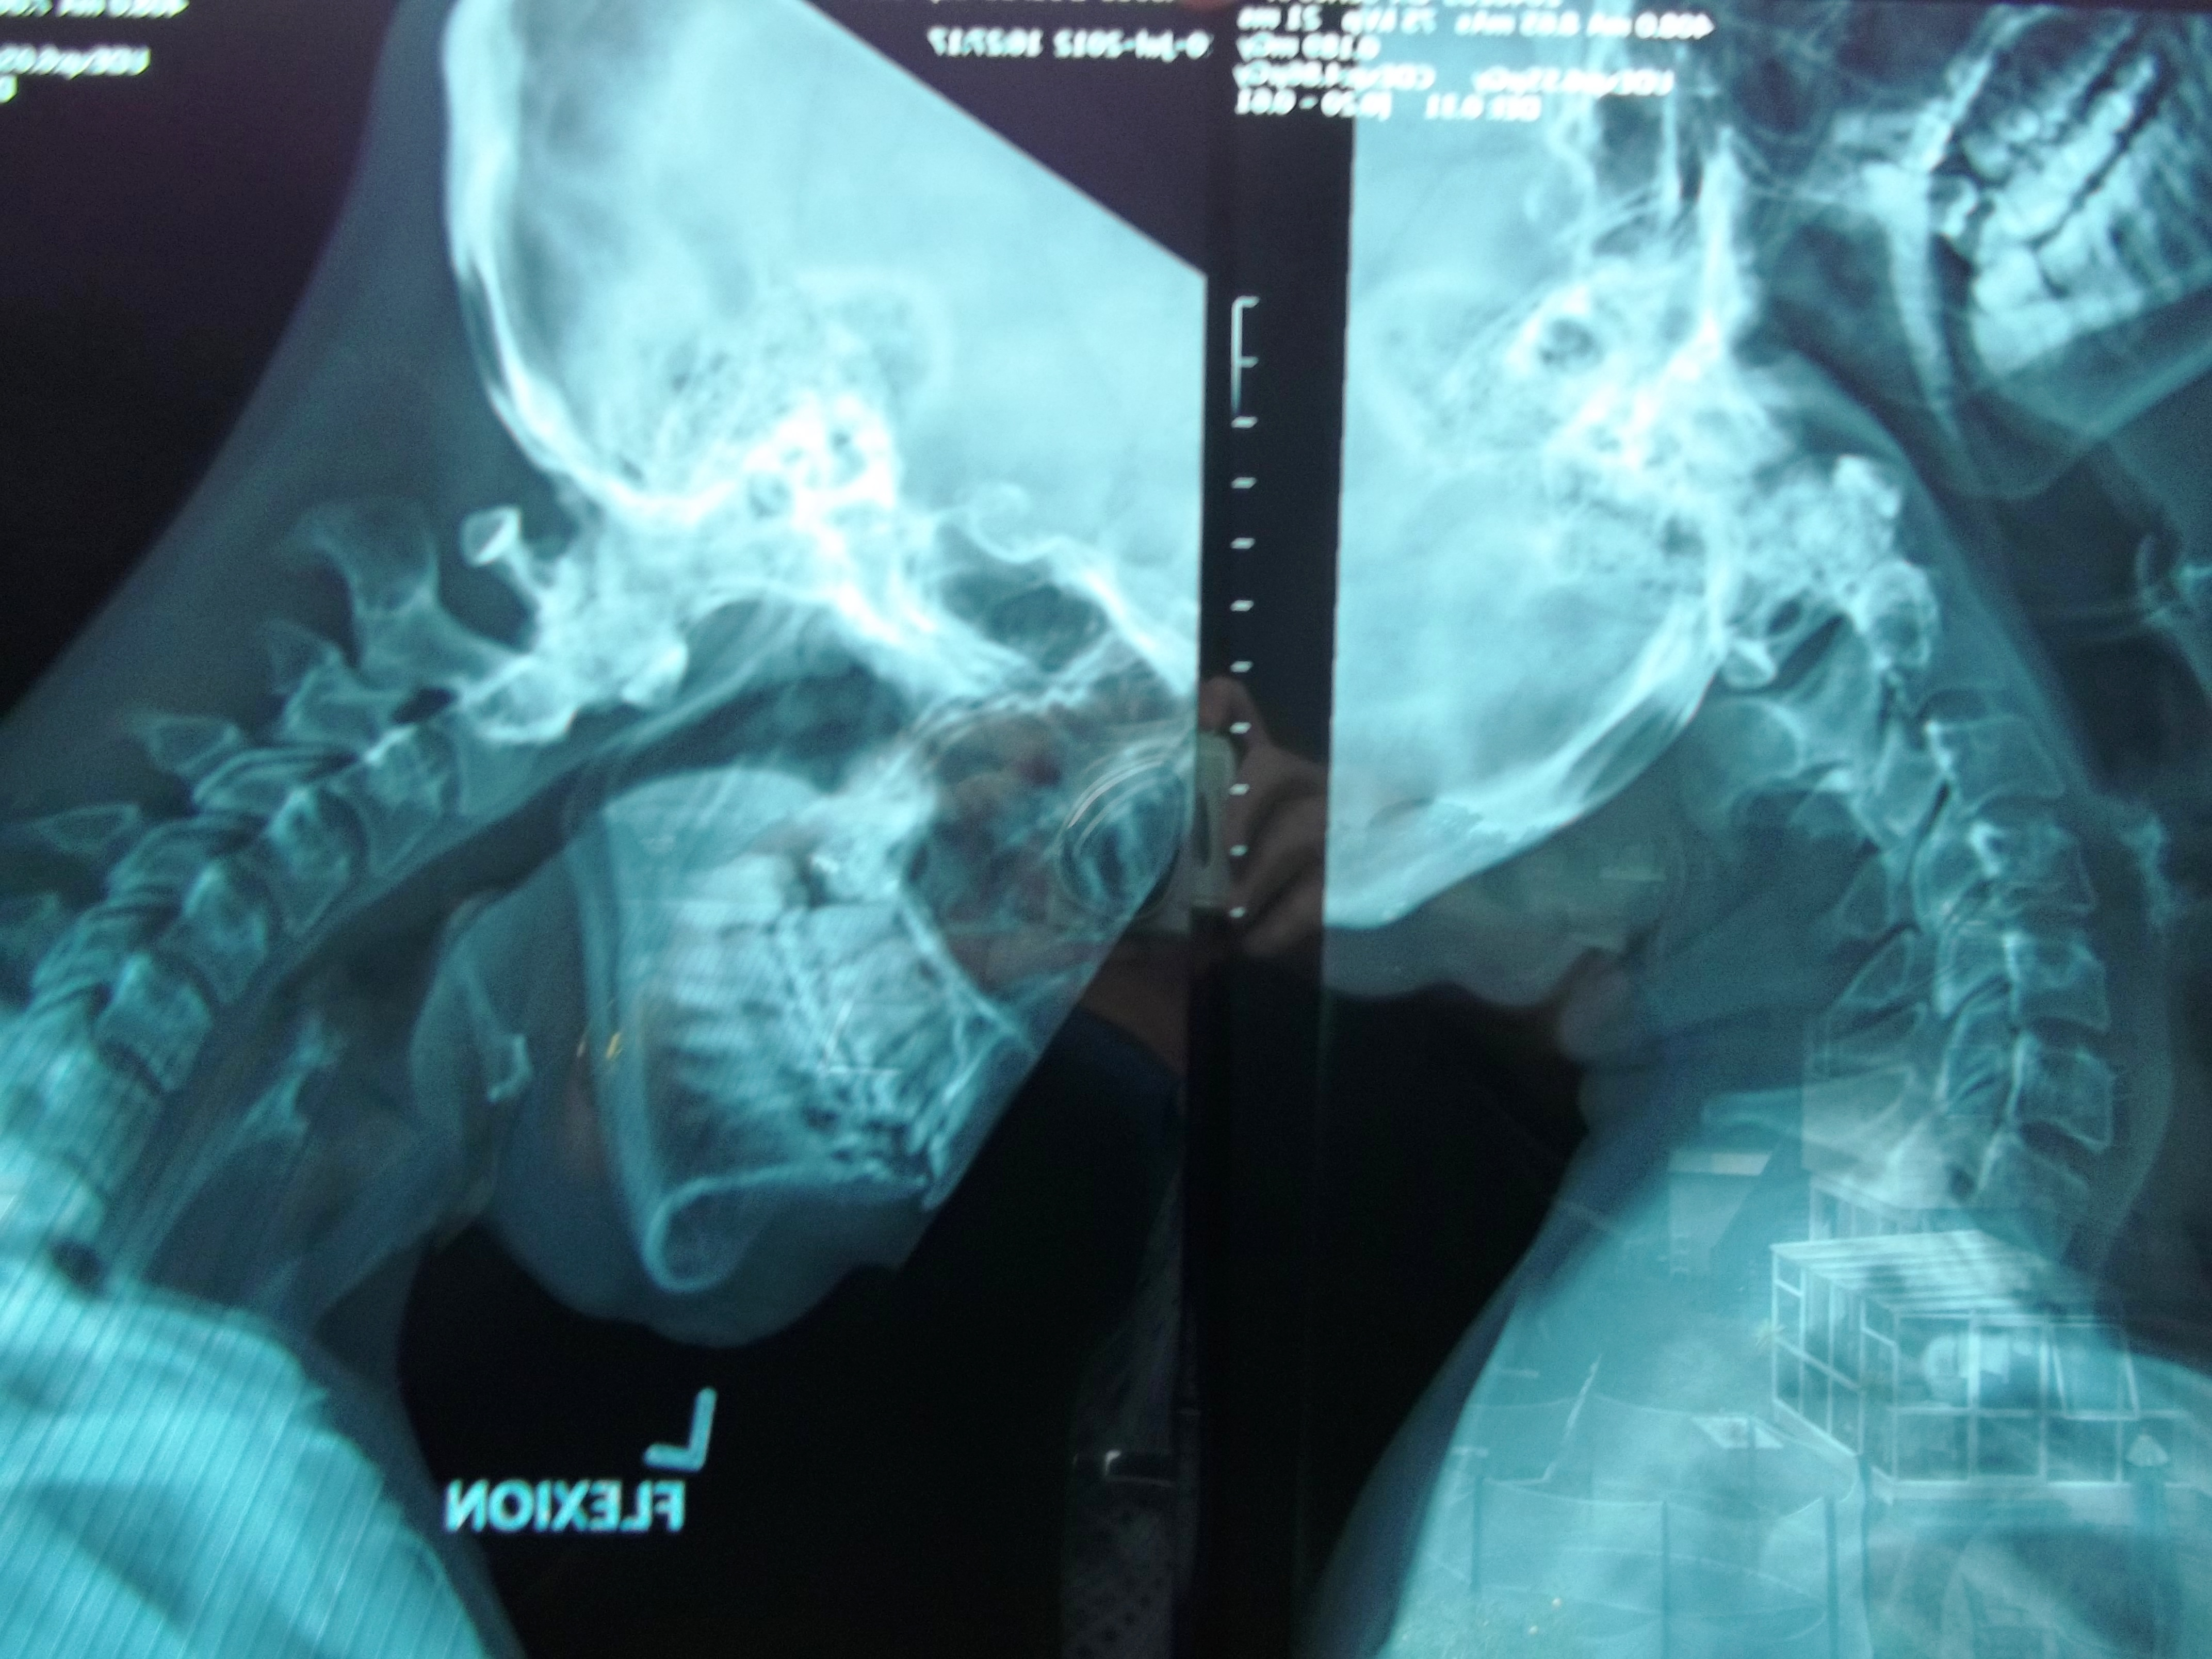
Catherine at NZCC with
Meniere’s & Trigeminal
C5 Kink

